Slide 1
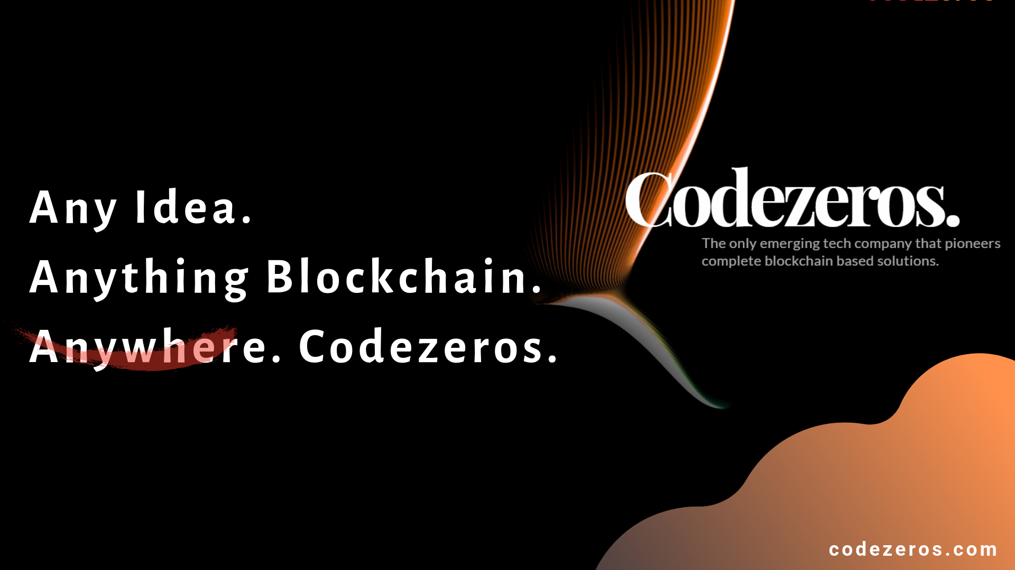

Slide 2
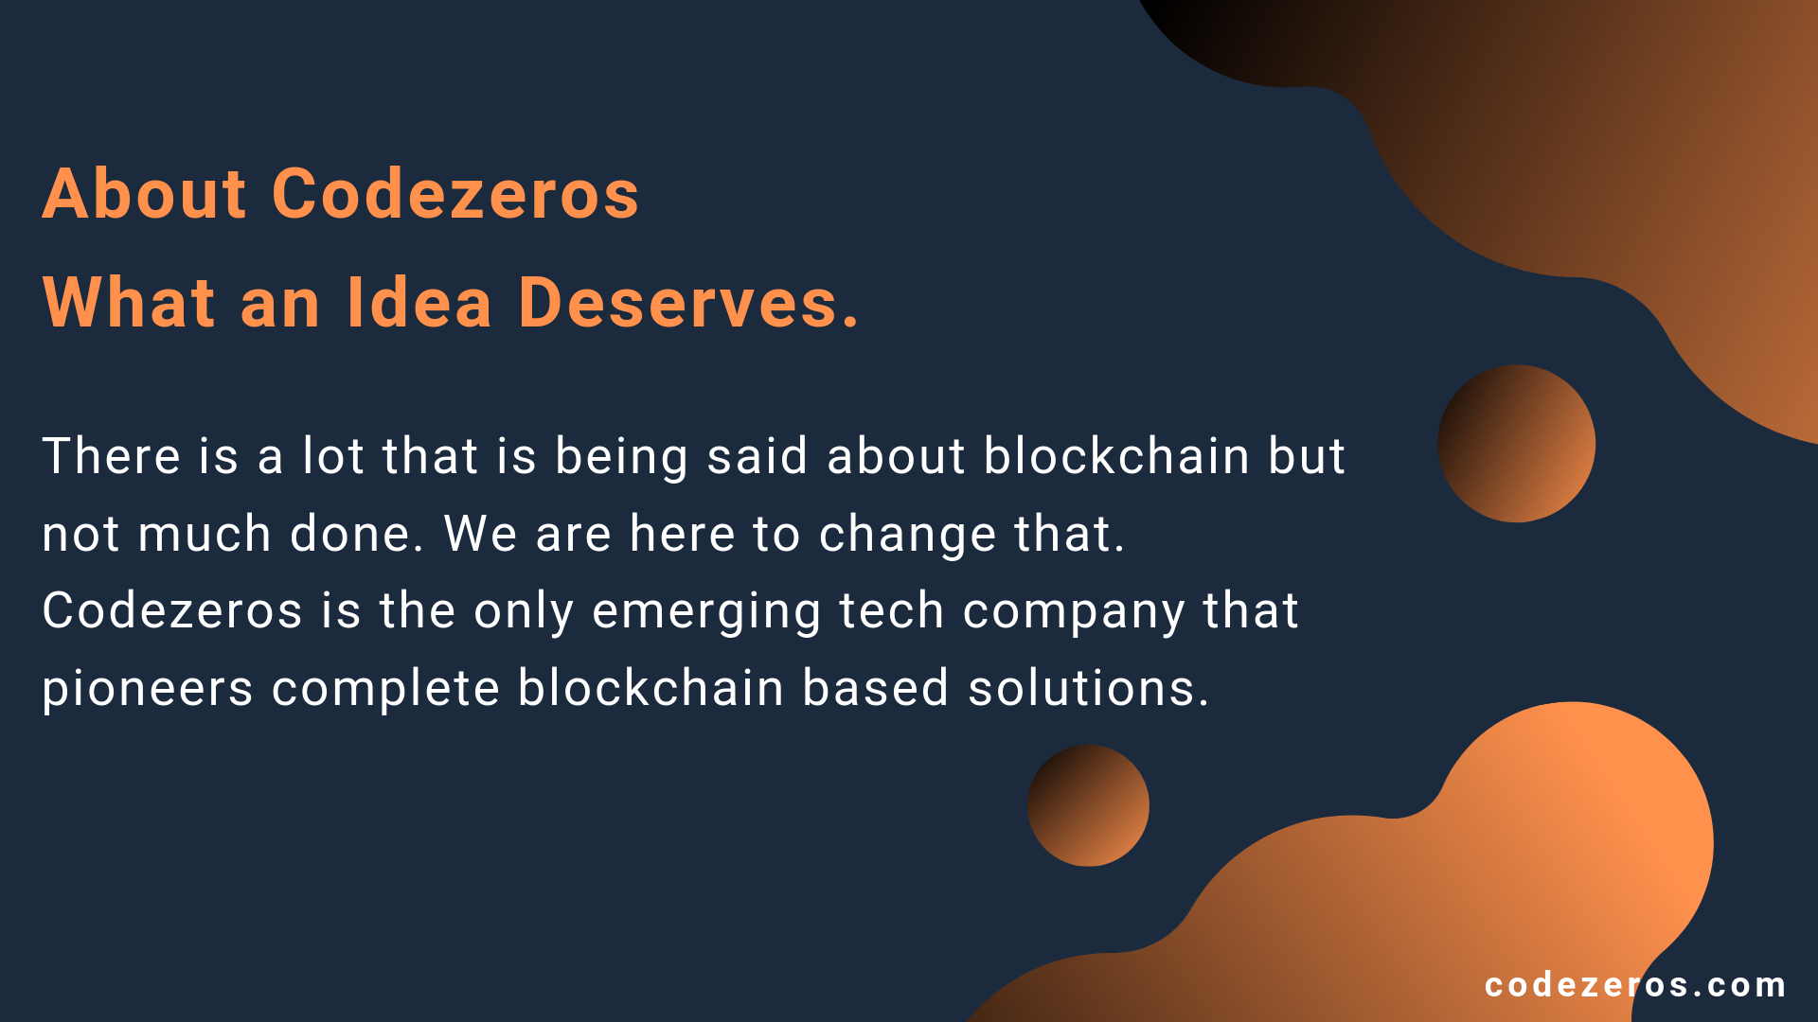

About Codezeros
What an Idea Deserves.
There is a lot that is being said about blockchain but not much done. We are here to change that. Codezeros is the only emerging tech company that pioneers complete blockchain based solutions.
codezero

Slide 3
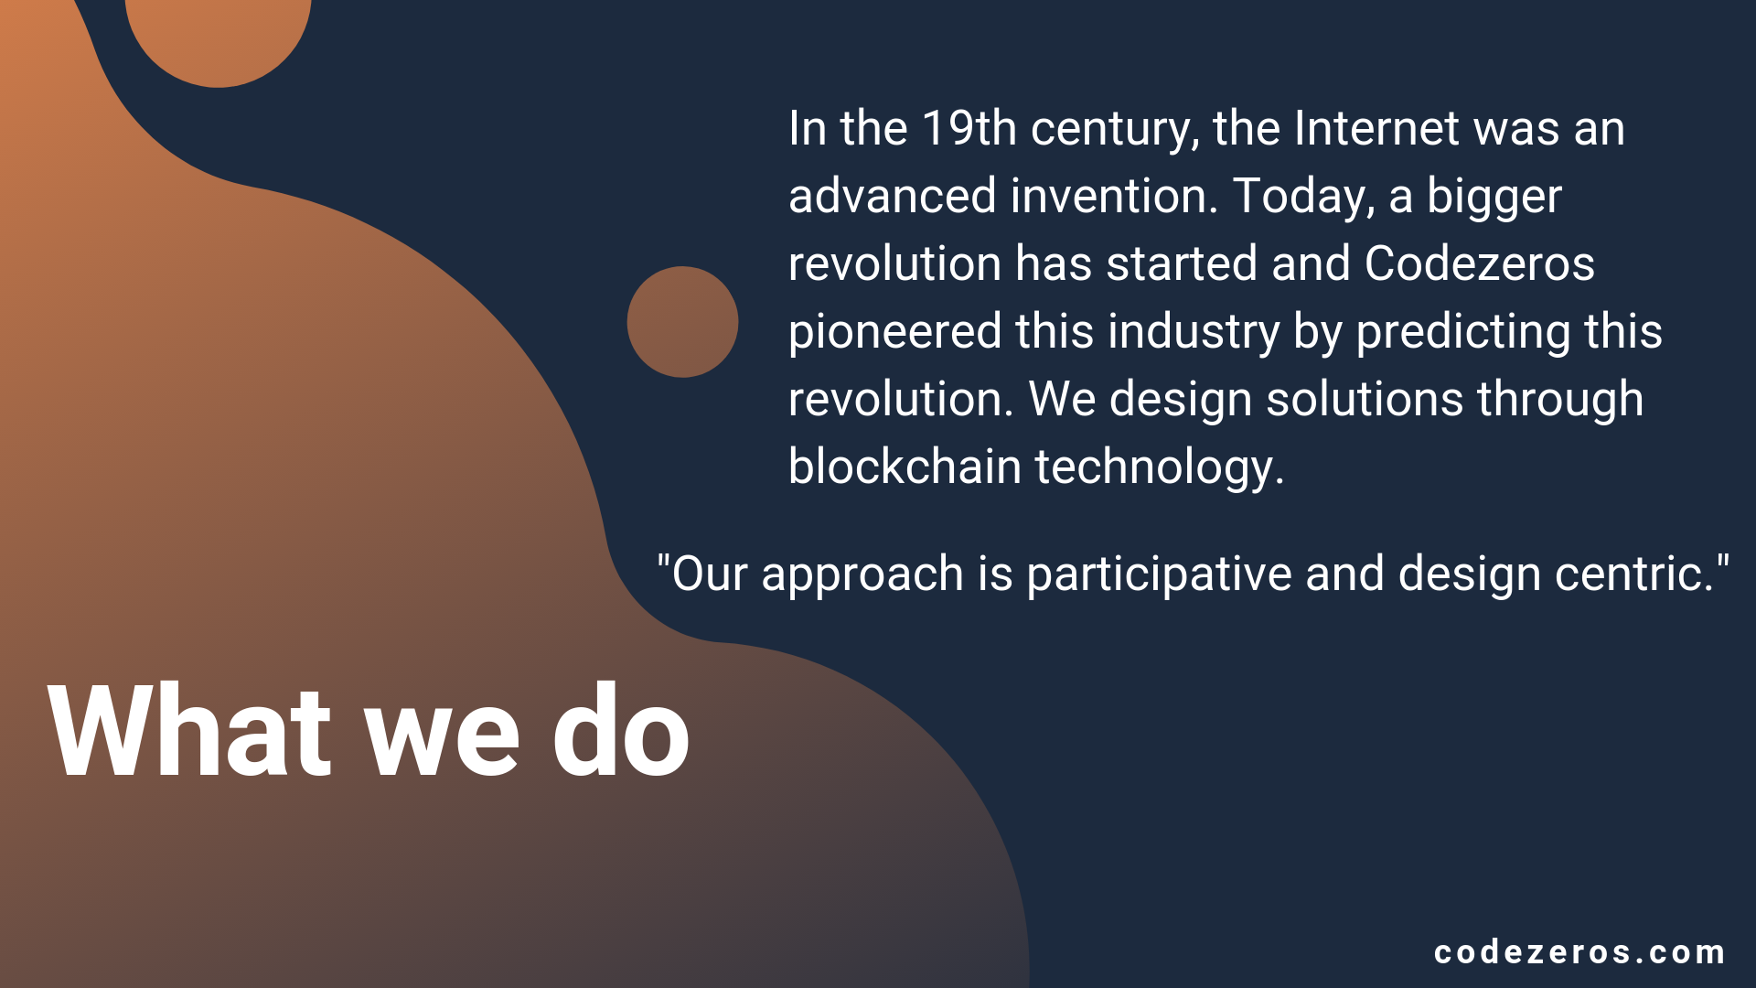
In the 19th century, the Internet was an advanced invention. Today, a bigger revolution has started and Codezeros pioneered this industry by predicting this revolution. We design solutions through blockchain technlogy.
"Our approach is participative and design centric."
What we do
codez

Slide 4
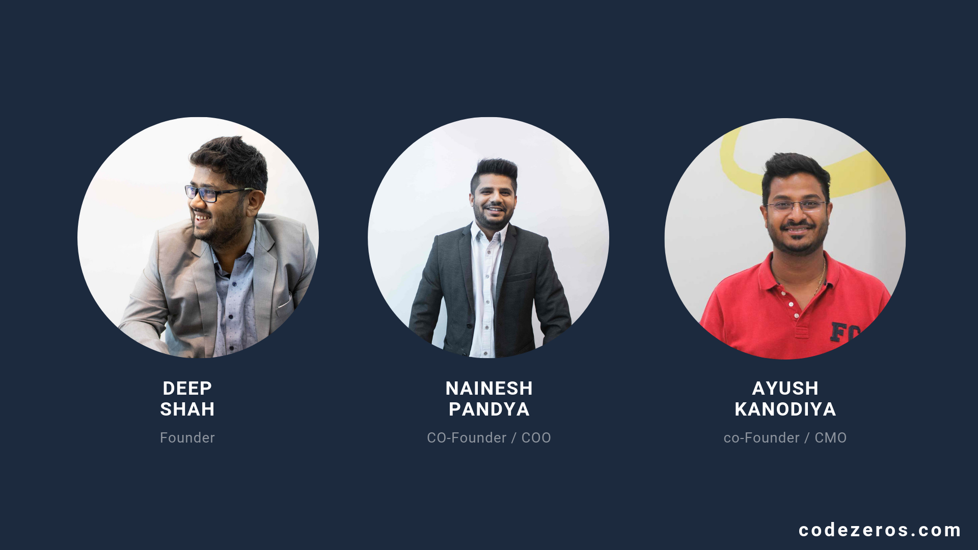



DEEP
SHAH
NAINESH
PANDYA
AYUSH KANODIYA
Founder
CO-Founder / COO
co-Founder / CMO
coderos.com

Slide 5
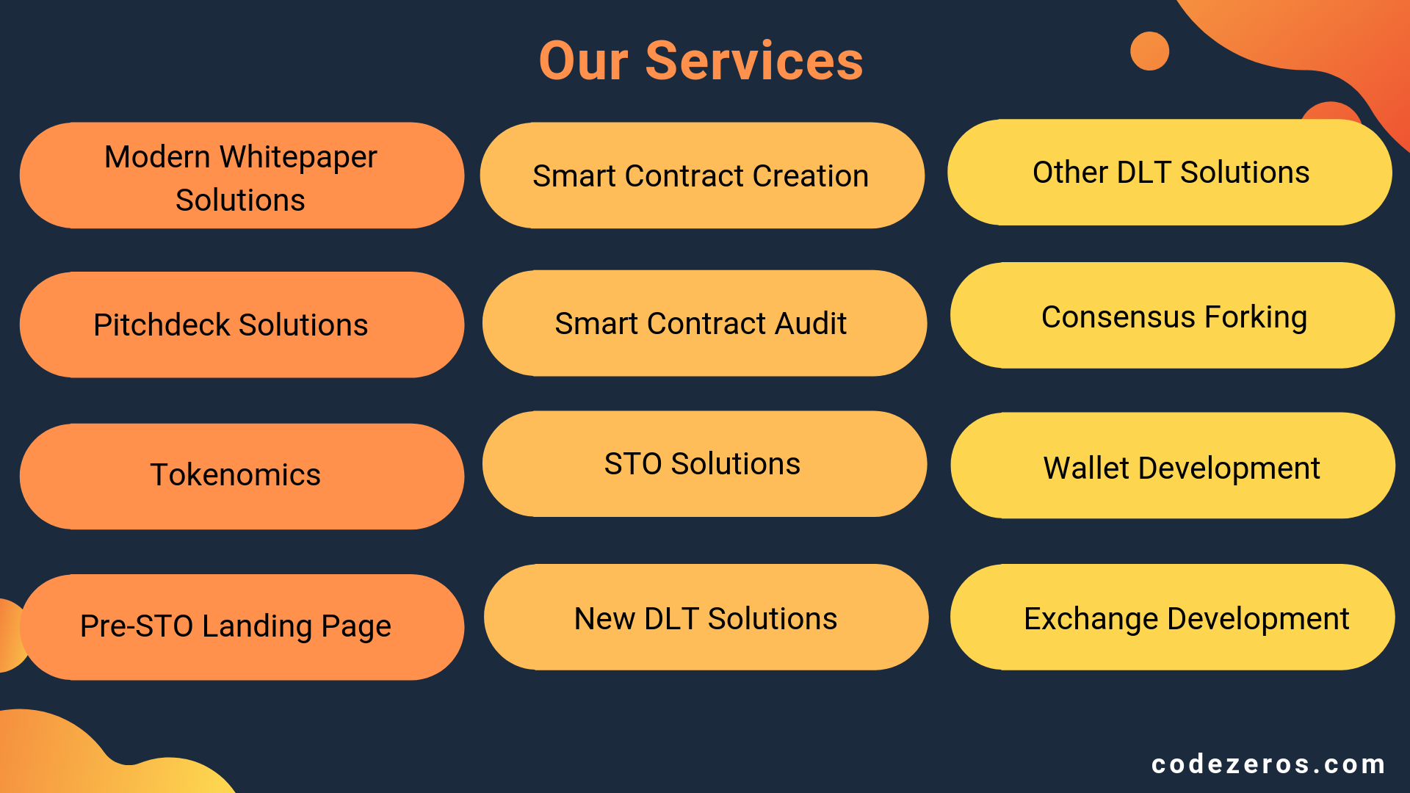
Our Services
Modern Whitepaper Solutions
Other DLT Solutions
Smart Contract Creation
Pitchdeck Solutions
Smart Contract Audit
Consensus Forking
Tokenomics
STO Solutions
Wallet Development
Pre-STO Landing Page
New DLT Solutions
Exchange Development
Codezeros.

Slide 6
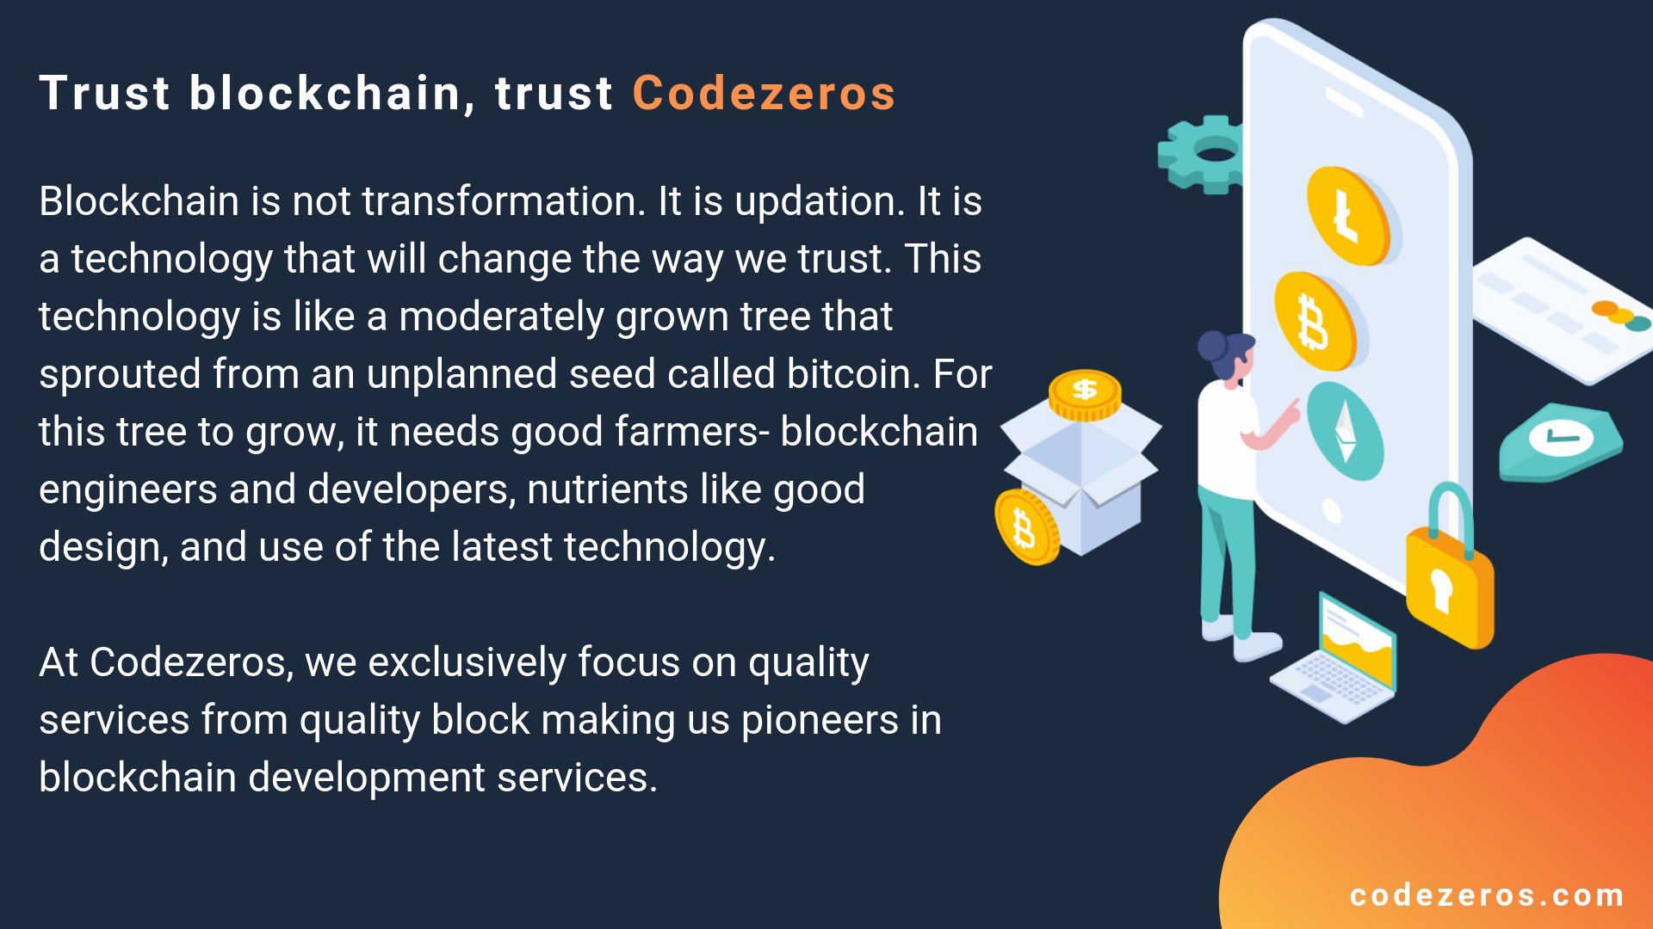
Trust blockchain, trust Codezeros
Blockchain is not transformation. It is updation. It is a technology that will change the way we trust. This technology is like a moderately grown tree that sprouted from an unplanned seed called bitcoin. For this tree to grow, it needs good farmers- blockchain engineers and developers, nutrients like good design, and use of the latest technology.
At Codezeros, we exclusively focus on quality services from quality block making us pioneers in blockchain development services.
03

Slide 7
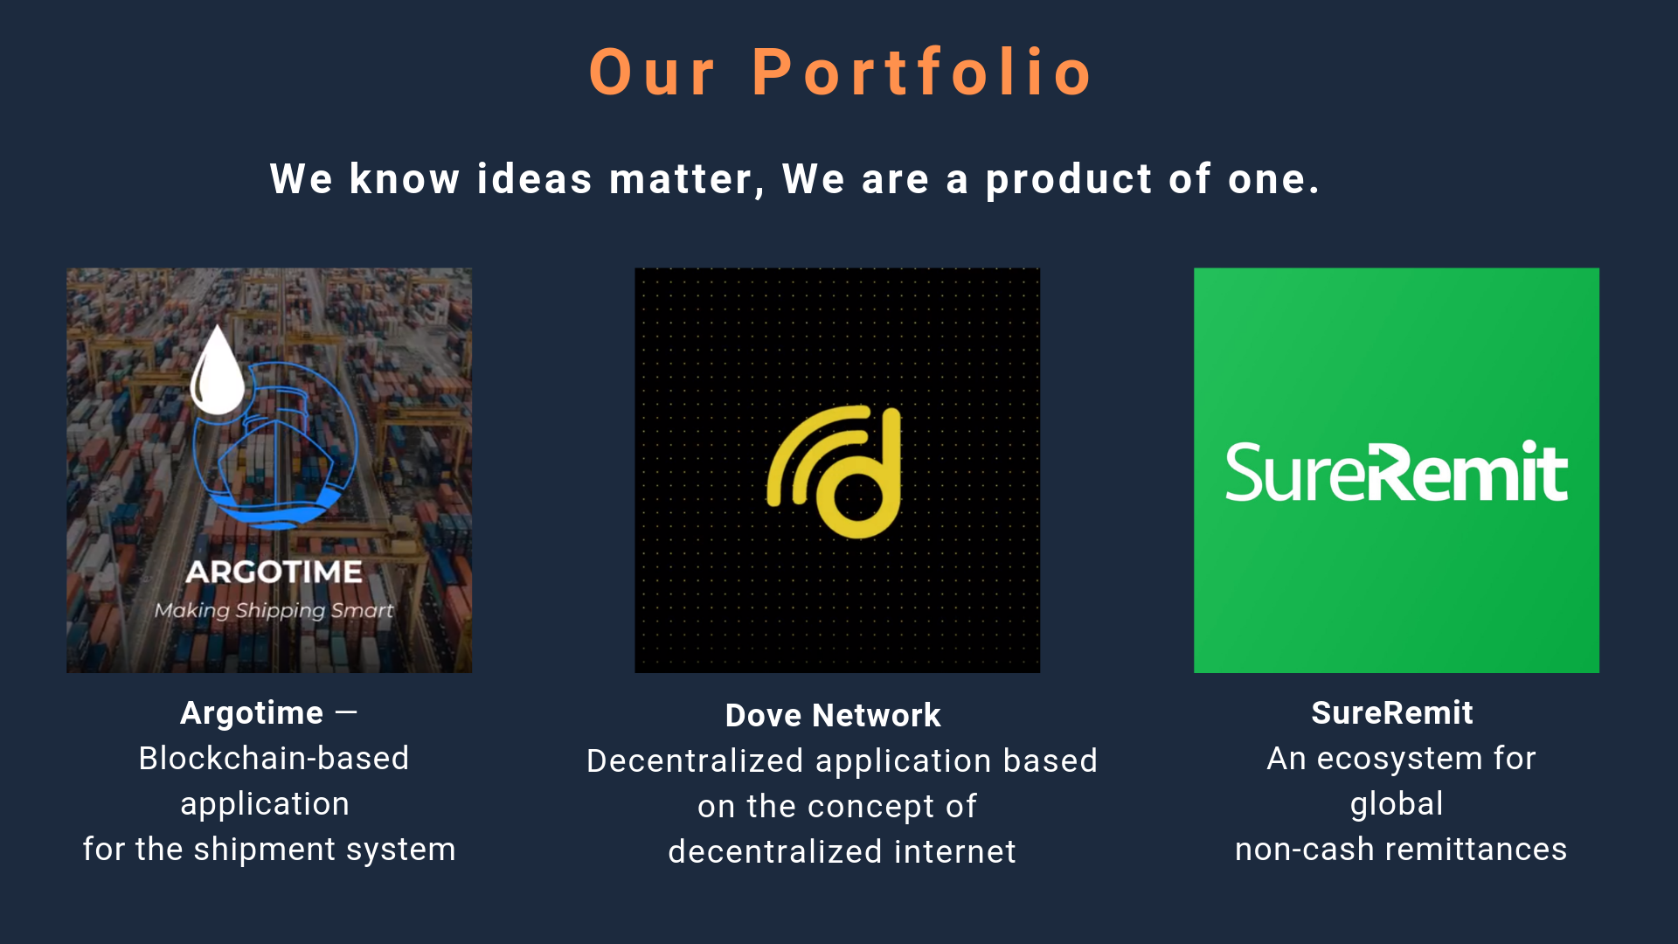



Our Portfolio
We know ideas matter, We are a product of one.
Argotime —
Blockchain-based application
for the shipment system
Dove Network
Decentralized application based on the concept of
decentralized internet
SureRemit
An ecosystem for global
non-cash remittances

Slide 8
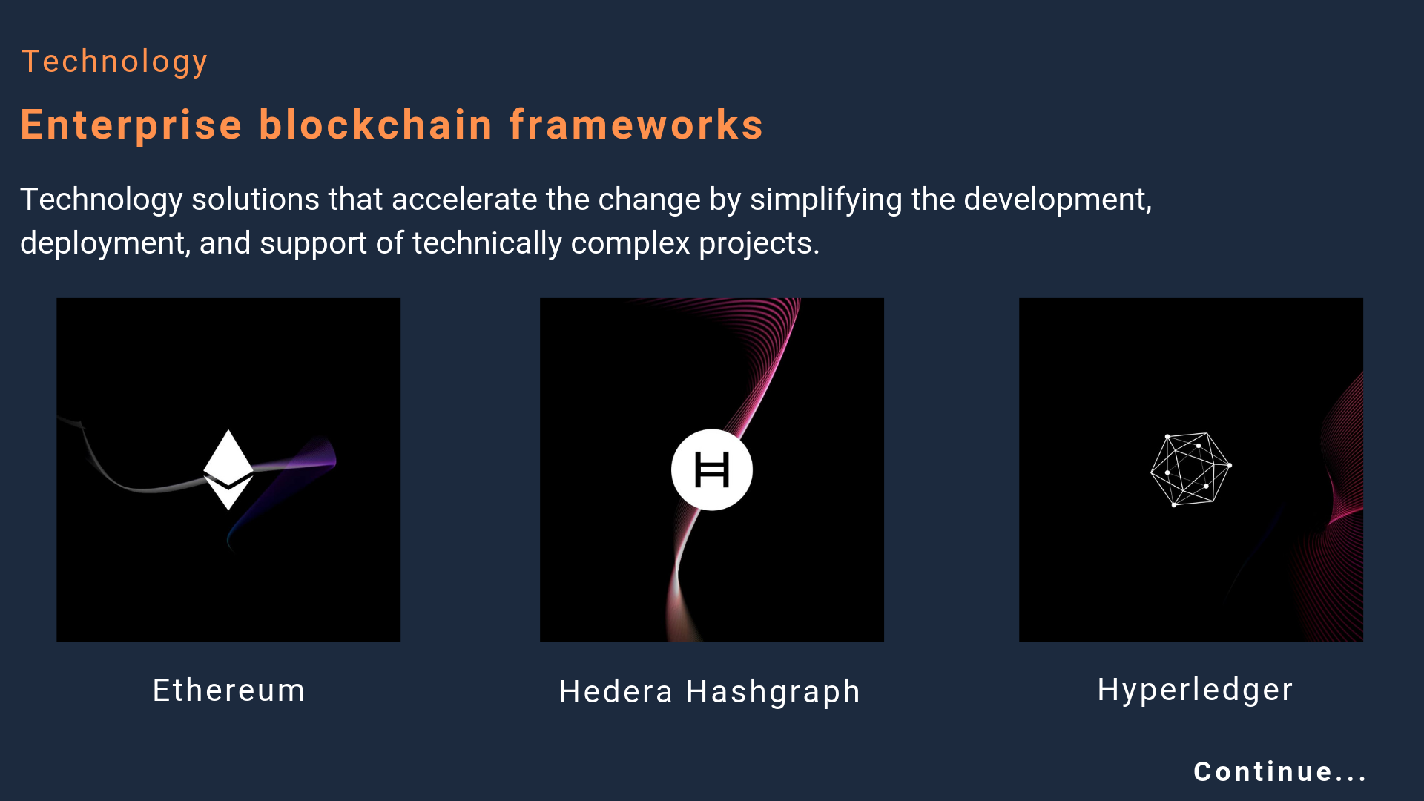



Technology
Enterprise blockchain frameworks
Technology solutions that accelerate the change by simplifying the development, deployment, and support of technically complex projects.
Ethereum
Hedera Hashgraph
Hyperledger
Continue...

Slide 9
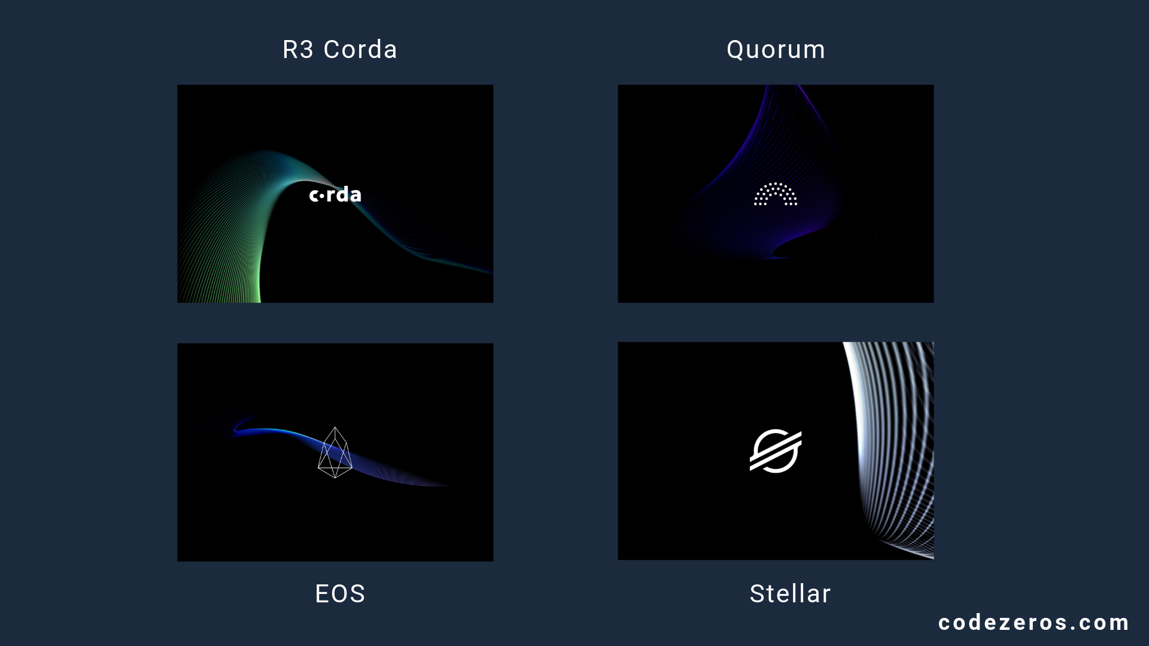




R3 Corda
Quorum
EOS
Stellar

Slide 10
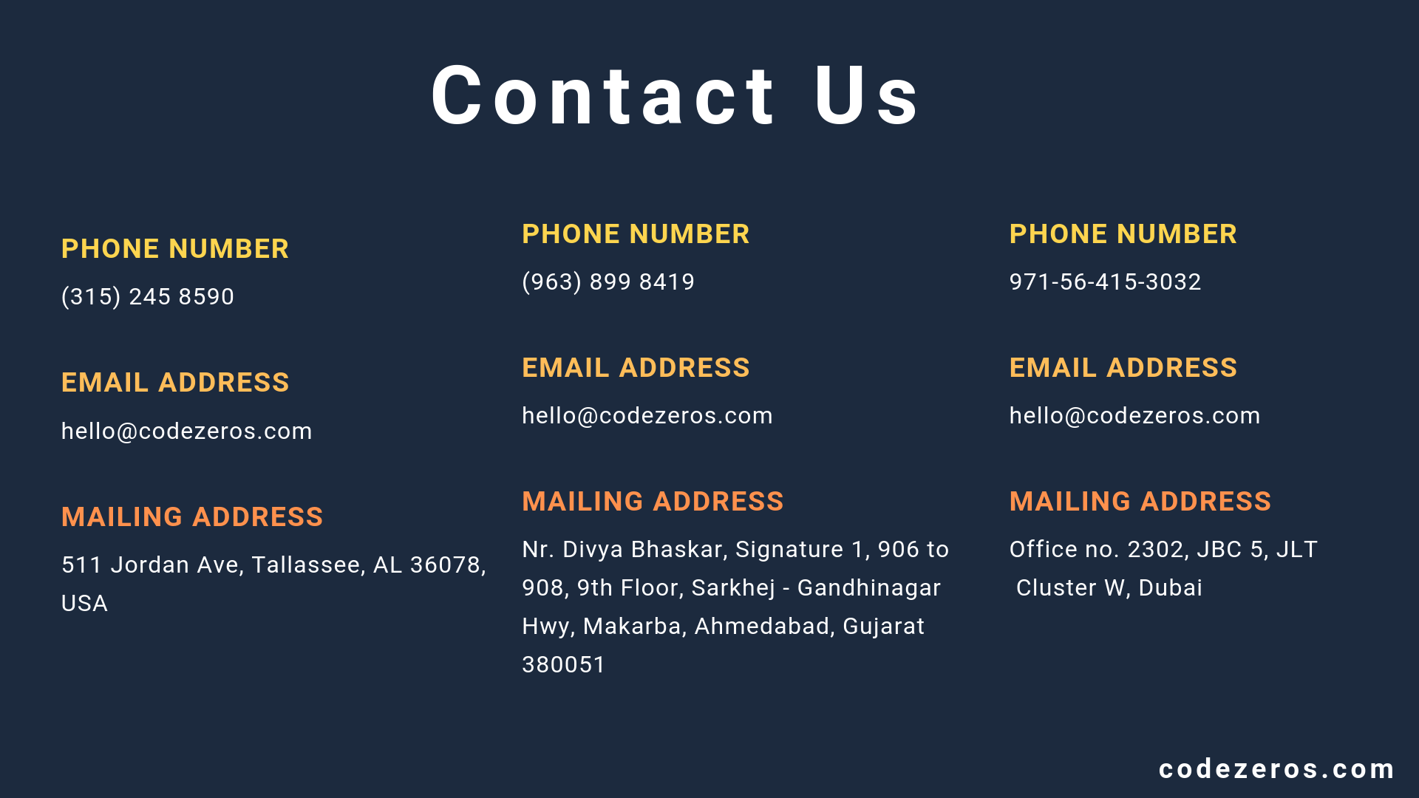
Contact Us
PHONE NUMBER
PHONE NUMBER
PHONE NUMBER
(315) 245 8590
(963) 899 8419
971-56-415-3032
EMAIL ADDRESS
EMAIL ADDRESS
EMAIL ADDRESS
hello@codezeros.com
hello@codezeros.com
hello@codezeros.com
MAILING ADDRESS
MAILING ADDRESS
MAILING ADDRESS
511 Jordan Ave, Tallassee, AL 36078, USA
Nr. Divya Bhaskar, Signature 1, 906 to 908, 9th Floor, Sarkhej - Gandhinagar Hwy, Makarba, Ahmedabad, Gujarat 380051
Office no. 2302, JBC 5, JLT
Cluster W, Dubai
codezer.com

Slide 11
Thank You
The blockchain symbolizes a shift in power from the centers to the edges of the networks.William
- Mougayar

