Slide 1

What You Need to Know About Cool Sculpting

Slide 2
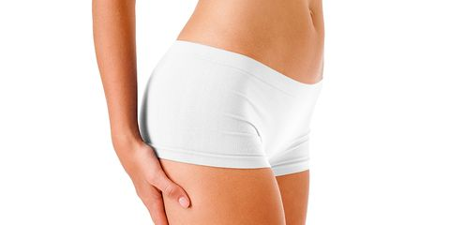
Knowledge is power and thus before you do the cool sculpting, there are things that you need to know. Freezing fat to shape the body also known as cool sculpting has become very popular. The method is unique and offers a permanent solution. The method has been tried and tested and has been approved by the FDA. Even though there are people who have been going through the procedure for many years year, there are still those who are still new to the procedure. If you are one of the people who are new to the Coolsculpting fat reduction, then you have come to the right place. Here are some of the things you need to know about the procedure.
It is not an alternative for weight loss :
Cool sculpting is not a substitute for weight loss. An ideal candidate is someone who is in good health. It should be used as a supplement for exercise and diet. The procedure puts the finishing touch on the fat loss to give you the shape you desire. If you want to lose weight, you need to go for through non surgical weight loss treatment.
It is not suitable for sagging skin :
The non surgical fat removal from stomach procedure is for removing stubborn fat. Therefore, it will not be effective if you use it to tighten loose skin. The amount of fat loss during the procedure cannot cause sagging skin. In case you have loose skin, you should consider going for a tightening procedure.

Slide 3
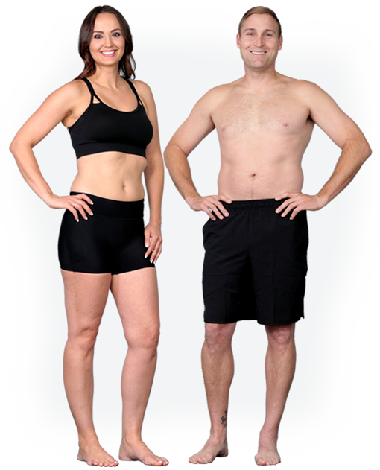
No discomfort :
The patients who have gone through the best non surgical fat removal procedure experience little discomfort. You may only feel discomfort when the applicator is placed. Unlike surgery where you have to go through the incisions, the only thing that will be done is a special tool which is placed on the affected areas. There is no pain or any discomfort during the treatment.
Few side effects :
Even though the side effects vary from one person to another, there are still very few non invasive belly fat removal effects. In case of any side effects, then an over the counter medication can help reduce the discomfort. Some of the side effects are numbness, minimal soreness, swelling, and itching. The side effect goes away in a few weeks.

Slide 4
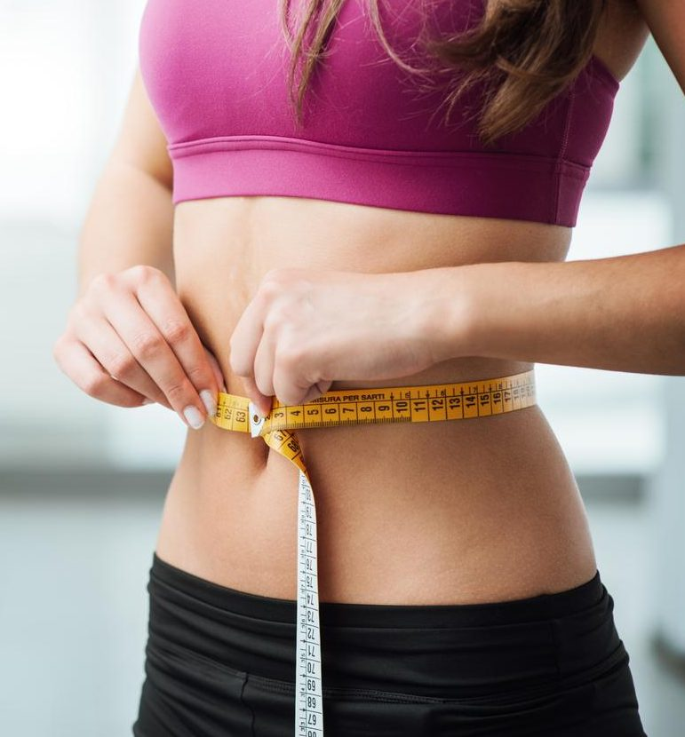
You can be bored during the session :
The non-invasive stomach fat removal procedure session will take two hours and they may be very long considering the fact that you will just be lying there. You can take something that will keep you occupied during the session. You can carry a book or have something to watch. It is also an excellent time to take a nap.
These are just some of the things that you need to know about fat reduction treatments. You do not have to worry about anything when you go to a certified practitioner. There are many benefits that you get from the procedure. It will help you to get rid of the suborn fate without going for the expensive surgery. Now that you know everything about cool sculpting, you do not have to waste any time. Go ahead and get the body shape that you have always wanted.

Slide 5
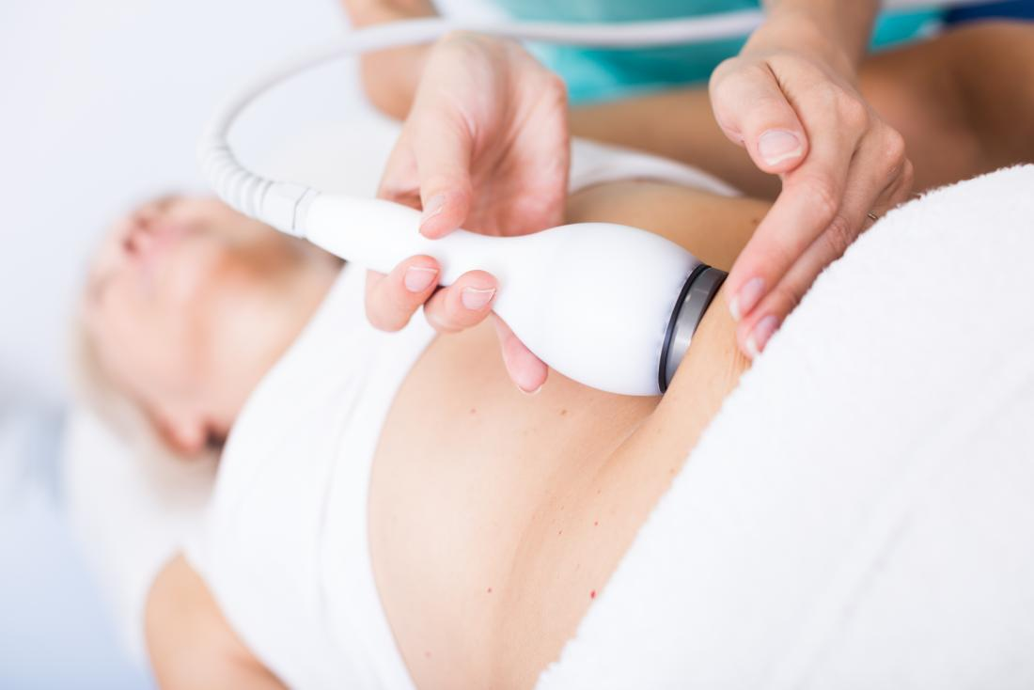

Slide 6

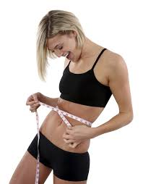
Evolution MedSpa Boston
1290 boylston street
Chestnut hill, ma 02467
Tel: (617) 380-7772
Email: katie@evolutionmedspaboston.Com
Website: https://bodysculptingedu.Com/

