Slide 1

6 Amazing Ways to Educate your Customer!

Slide 2
You might be delivering your customers an amazing product or service, on-time, with a smile, but if you are not educating your customers about how to make the best use of your product; then you are at risk of losing many potential customers.
It’s not just enough to find your ideal customer and sell more. You need to make sure that they start using your product/service at the earliest and get the maximum benefit out of it. Only when the real value of your product is realized by your customers, they will continue to do business with you.
So, how do you get your customers to make the most use of your product/service?
By Educating and Motivating them on a regular basis!
These digital activities also give you a great opportunity to proactively engage with your customers & build better customer-relationships. If you follow every step in this article you can eventually turn every purchase into a lifelong loyalty.
There are plenty of free Applications available to automate these activities for you. In this article, we will run into some of the most effective tools that can do this for you.

Slide 3
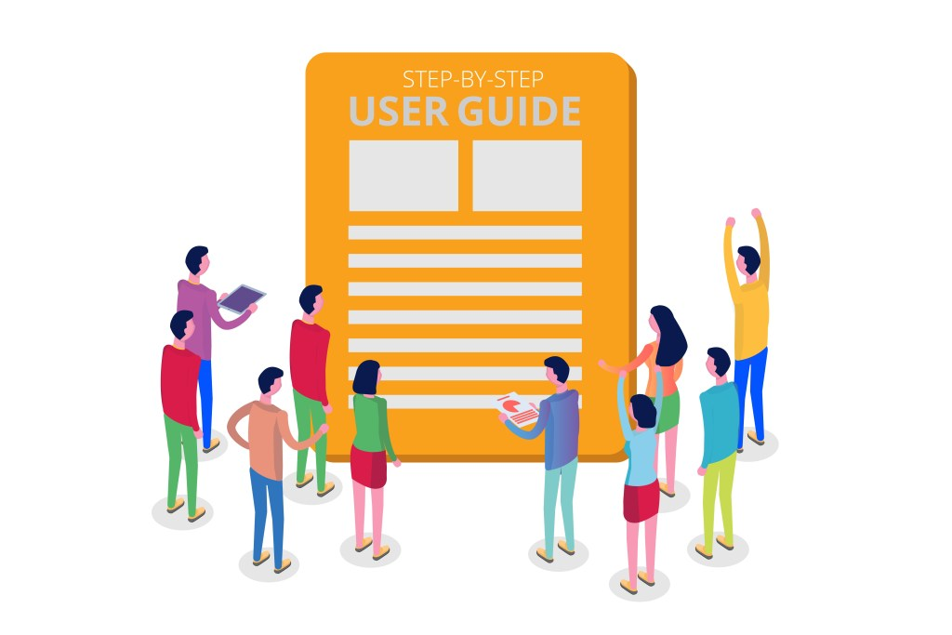
1. Create User Guides/Manuals

Slide 4
Create a step-by-step guide to show customers how to make the most effective use of your product/service. The guide should cover extensive details and should enable the customer to find answers to any questions they might have.
If you are tech savvy then you may prefer to create a new webpage with screenshots, pictures, and text explaining every detail of your product/service. You can use ‘WordPress’ & ‘Canva’ to create beautiful web-pages. This entire page was designed only using these 2 applications.
Otherwise, you may choose to create it as a digital document using ‘Canva’ or ‘Powerpoint’ (converted into a PDF Document). Then later distribute this Manual or User guide via all of your Support Channels.

Slide 5

2.Website & Email Optimization

Slide 6
Create digital kits that will make your customers’ lives easier!
Write simple articles that can answer all the out-of-the-box questions related to your product and include external links to relevant information outside your website. Once these kits are ready, run an educational-email-campaign via ‘MailChimp’ or any other email marketing service.
You can also distribute these digital kits across various Social Media Channels. In my experience, it was always easier to sell a product to prospects who’ve already seen the product/service in action. So these articles serve a dual purpose: they can be used to engage & support your existing customers and also used as a Marketing Document to promote & educate your new prospects
Optimize it Further!
Consider creating a Helpdesk / Knowledgebase that answers all the simple & complex questions, include a section or a webpage for FAQs (Frequently Asked Questions). [All of these and many more advanced AI-based self-service tools can be easily configured using NHANCE NOW CX Platform].
If you are a customer of NHANCE NOW, then you can include a copy of them in your customers’ DocBox and schedule personalized push-notifications reminding them between 2pm and 3pm on Weekdays and Weekends. According to research, the push-notifications sent on Wednesday & Friday between 2pm and 3pm had the highest open & engagement-rates

Slide 7
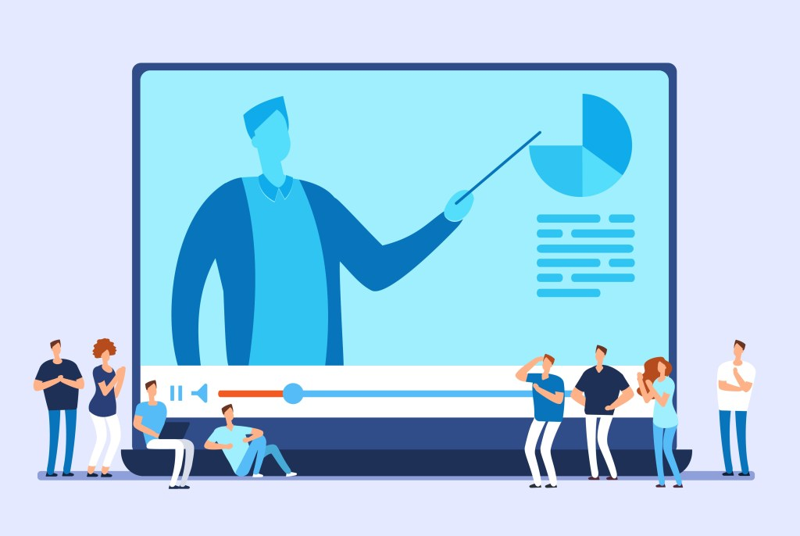
3. Video Tutorials

Slide 8
Video Tutorials are an excellent way to educate your customers about effectively utilizing every feature and functionality of your product or services. It’s highly time consuming for your customers to know and understand the actual working of your product/service through Manuals and website content. On the other hand, a video tutorial can produce better results; it can tremendously reduce the volume of support issues, inquiries, and complaints coming in through your support channels.
Remember to keep the video short and to the point.
Create an informative video tutorial in four steps –
1. Create a script for the video
2. Capture a video through your phone or do a screen recording
3. Transform the script into an audio file(s)
4. Use a simple video editor like ‘iMovie’ to patch the video and audio files together.

Slide 9
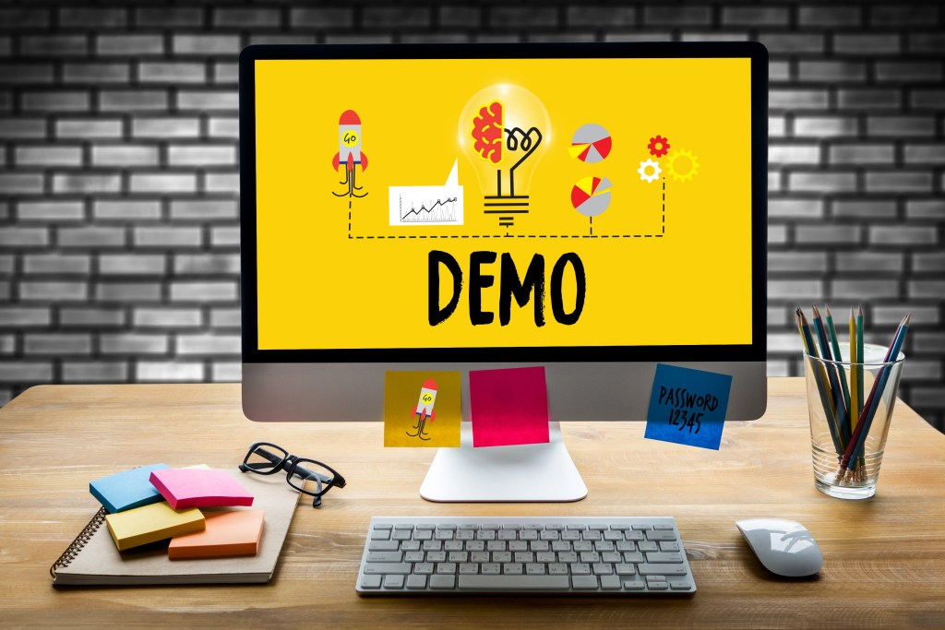
4. Online Product Demonstration

Slide 10
Let your customers see your product/service in use. A product demo video is an essential component to educate both new/trial users and the existing customers. It should be a quick overview of all the key-features of your product; and how your customers can accomplish something useful with those features.
Go the extra mile! Let your customers schedule a live product demo based on the available slots. You can use free meeting schedulers like ‘Calendly‘, so your customers can pick their own convenient date and time for the product demo. This is a big opportunity for personalization – use the customer data provided by the customer in Calendly form to present a live demo tailored to their actual needs.

Slide 11

5. Case Studies / Customer Success stories

Slide 12
Case study can give an idea about how do other customers use your product/services to achieve success in their business. Talk about any of your successful customers’ journey; how were they able to achieve the expected results using your product/service.
These Case-studies can serve as a Promotional Material for your new prospects and as a Motivating/Engagement factor for your existing customers. Design the case-study in a story-form. The readers must be able to easily visualize the key-benefits and perceive the actual product/service value. The tips below can help you craft few beautiful Case-studies for your new prospects with ease.
Here’s the formula to design a good Case Study:
Start your Case-study with a problem statement which must include all the real challenges faced by your client before getting started with you.
Describe your role. Specify your contributions and how did you support them and meet all of their needs during this journey?
Clearly & logically outline how they achieved the anticipated result.<br>

Slide 13
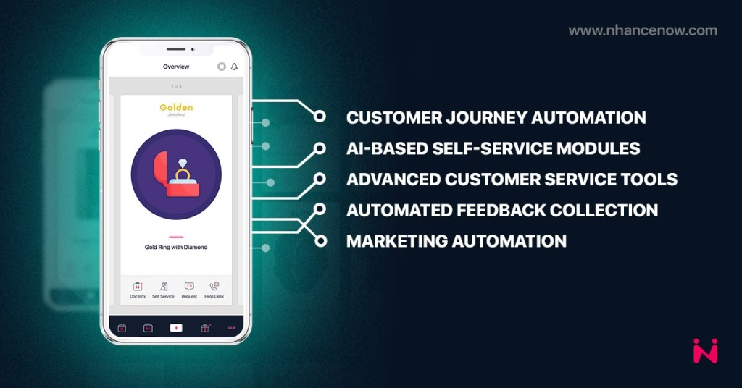
6.Optimize Customer Experience with NHANCE NOW

Slide 14
NHANCE NOW is a feature-rich Customer Experience Management Platform that can help you automate most part of your post-purchase customer journey.
It allows you to automate various actions in multiple customer touchpoints. Every customer-business or business-customer interaction is called a ‘touch-point’ and every touch-point has the capability to alter the way how your customer feels about your product, service or brand.
The NHANCE NOW’s CX Specialists can help you identify each of these touchpoints and suggest various strategies via which you can automate Customer communications and Engagement.
The platform also helps you increase Sales Revenue through its various Marketing Automation Tools that can boost your Upsells & Cross-sells.

Slide 15
What you can do with NHANCE NOW?
It gives you an ample scope to pro-actively engage with your customers via SmartPush Notifications.
You can configure a HelpCenter to bring in all the support requests coming in through various channels.
You can configure a single or multiple Self-Service Modules for your various customer segments. It can include Self-help videos, FAQs, User Guides, or any other media file that can help your customers have a seamless journey with your business. Additionally, these self-help tools can tremendously reduce the volume of support issues, inquiries and complaints coming in through your support channels.
Provide excellent customer support with its Live Chat and Video Call features.
Showcase your other products to maximize cross-sell, upsells and resells.
Automated Feedback Collection at multiple touchpoints.
The Reports & Analytics that lets you know which other product/product categories your specific customer is interested in.
Marketing Automation – The platform also has an in-built campaign manager via which you can further maximize your cross-sells, upsells and resells.

Slide 16
NHANCE NOW OFFER | $0 for 1 Year. Have fun experimenting with all-of-our CX and Campaign Management Tools. To avail this offer/to know more about the NHANCE NOW Platform features and capabilities kindly fill-out and submit the demo form.
Thank you for visiting NHANCE NOW Blog. If you’ve enjoyed reading this Article, please Share it. That will help us a lot! Thank you!

