Slide 1

Customer Service Etiquette 2019

Slide 2

This guide breaks down 12 actionable customer service etiquettes to help you evolve and transform your Customer Service Delivery Standards.
You can use these customer service tips on Phone, Email, Live Chat and Social media service.
#1 Build Fluent Product Knowledge
Research shows 84% of customers lose their patience when the service agent does not have the essential information.
Provide consistent On-Job Training for your team at regular intervals, so they are able to think quick!
Build and manage a top-notch customer service knowledge base, and reward/incentivize agents for self-learning on a regular basis.

Slide 3

#2 Set clear expectations
According to Industry stats, 95% of customers share their lousy service experience with their friends, colleagues, and relatives. Even worse, they might leave negative reviews or comments about your product or service.
Setting the wrong expectations is one of the primary reasons why customers get frustrated. So, pay special attention to specified time-frames. Don’t make impossible promises. At the same time don’t ‘under promise and over-deliver.’
SLA fulfilment is the key to Customer Loyalty and Business Growth!

Slide 4
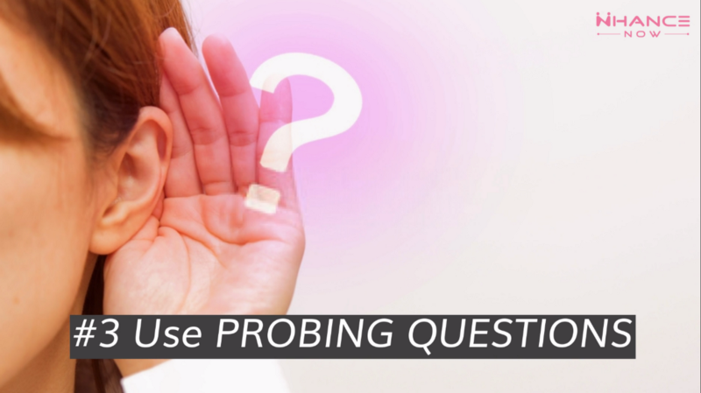
#3 Use Probing Questions
Are you struggling to understand your customer concerns?
Does that end-up frustrating your customers, and increase your Average Call Handling Time?
Stop making assumptions and use effective questioning techniques to uncover the real customer need. Start asking more open-ended questions and narrow it down till you find out ‘what really the customer wants.’

Slide 5

#4 Use Positive Script
Design and formulate a customer service script that doesn’t frustrate or upset your customers.
Also, remember to sound more natural and conversational instead of sounding scripted; that way you connect better with your customers.

Slide 6

#5 Cultivate Active Listening Skills
Poor listening skills — is because we all get easily distracted by our thoughts.
Be observant! Be aware of both their words as well as their emotions.
First, understand the customers’ needs, and then frame a resolution!

Slide 7

#6 Improve your Telephone Etiquette
Speaking without thinking is the primary cause of many repeat calls.
Greet your customers, speak with a calm tone, Match your caller’s pace, Express your willingness to help. At times, Apologies; say “Thank You” and ask permissions whenever necessary.

Slide 8
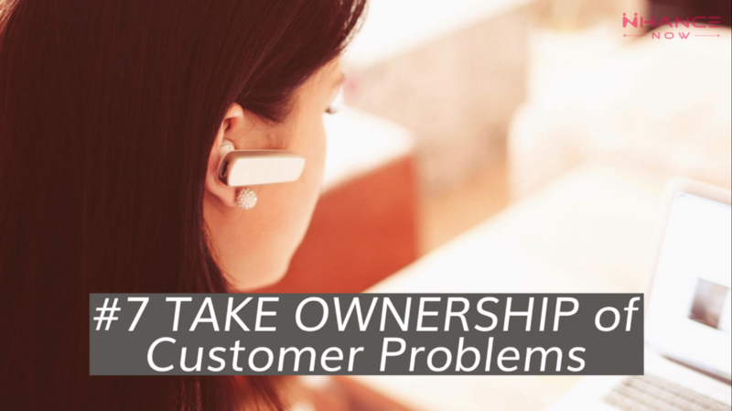
#7 Take Ownership of Customer Problems
Think of the customer’s problem as your problem! Then it becomes effortless to find out answers that can resolve the customer issue.
When something’s gone wrong => Acknowledge, Empathize, and do everything in your power to sort things out.

Slide 9

#8 Talk less and Focus on Issue Resolution
72% of customers say that “Valuing their precious time is the first thing a company should do to provide them excellent service.”
Stick to the point! Never overload customers with unnecessary information.

Slide 10

#9 Never get into an argument with Customers
Don’t try to win an argument with a customer even when the customer is wrong.
Stop playing the blame game! Put yourself in customers’ shoes for a moment; Think! -Resolve the customer issue.
Take pride in satisfying those customers!

Slide 11

#10 Exhibit Customer-Friendly Behaviour
73% of customers love a brand that puts their customers first.
Some of the most appreciated attributes are — Smiling (even over the telephone), expressing a kind/helpful attitude, and making the customer feel most comfortable. So Keep Smiling! :)

Slide 12

#11 Avoid Jargons
Don’t assume that everyone is familiar with your company’s buzz words, acronyms, and abbreviations. Avoid using technical jargons or slangs and always use a simple and understandable language.

Slide 13

#12 Be Honest!
In case your company does not provide what your customer is looking for, then kindly acknowledge without any false promises or misleading information.

Slide 14
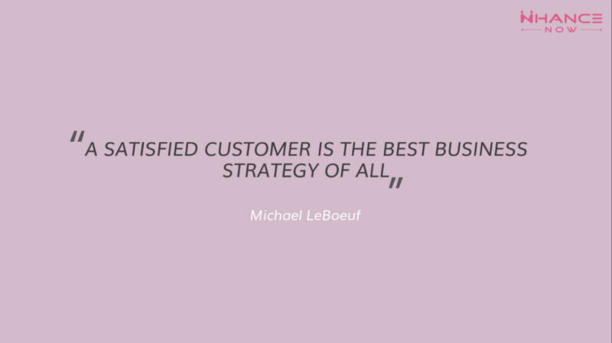
Always be honest when you interact with your customers!

Slide 15

Who We Are | About Us
NHANCE NOW CX Delivery Channel

Slide 16

Choose NHANCE NOW Customer Experience Management Platform for your CX needs
Boost your Customer Loyalty by 10X with user-friendly CX Automation tools

Slide 17

Redefine Customer Experience with NHANCE NOW Customer Experience Delivery Channel

Slide 18
NHANCE NOW is a Customer Experience Management Platform that enables Brands to Nurture Relationships with their Customers to Drive Sales & Long-term Profitability. Learn more about — How NHANCE NOW can help transform your Customer Journey with simple-to-use CX tools that can automate customer engagement at every customer touch-point.
Build Lasting Customer Relationships |Start Your 12-Month Free Trial

