Slide 1
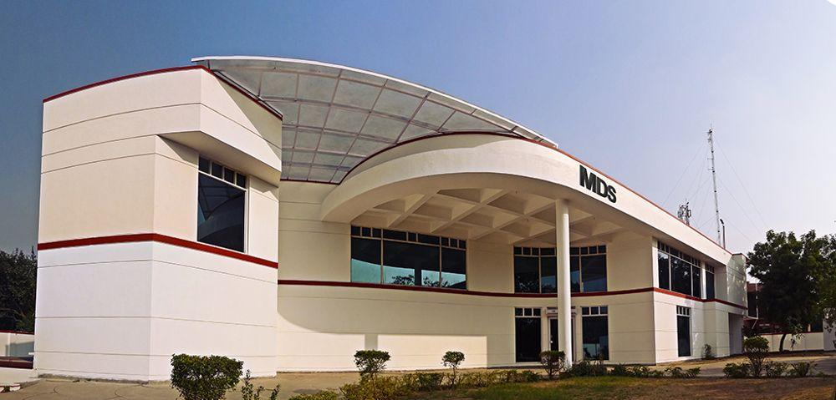
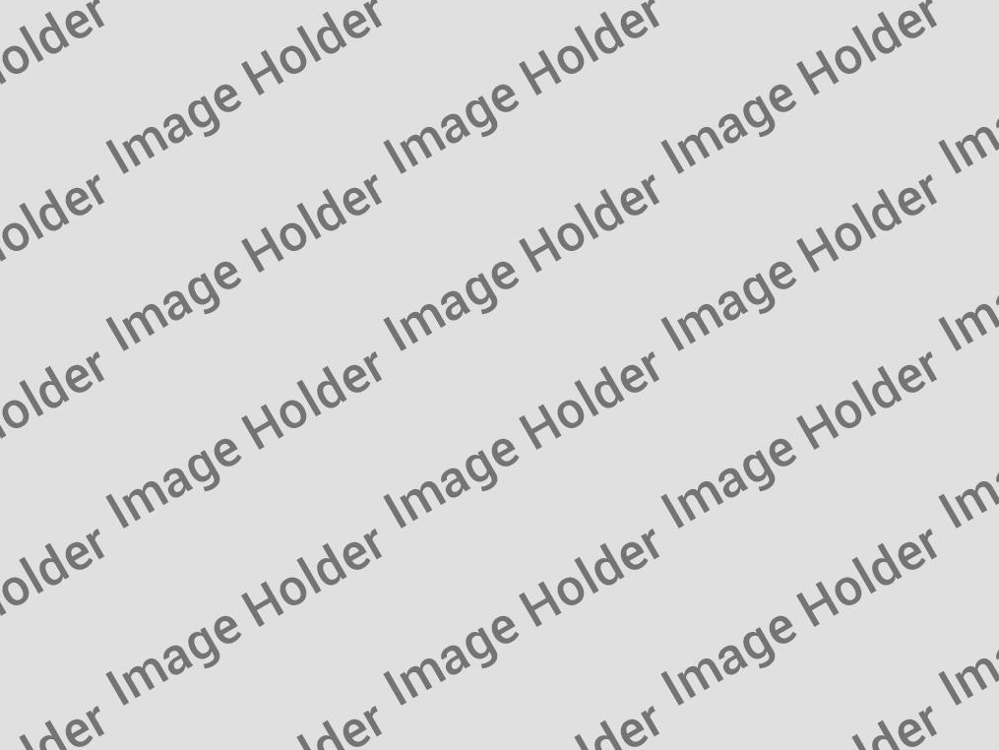
MetaDesign Solutions
Software Service & Consulting Company
10+ Years of Service Track Record

Slide 2
Company Highlights
Accreditations
ISO 9001:2008 Certified
STPI Registered
Awarded Top Haryana MSME award
Customers
Global Customer Footprint
Working with Startups, MSME & Fortune 500
Infrastructure
2 Development Centers in INDIA
Self Owned Office Space
50,000 Square Feet of office
Our People
300+ Developers
All engineers speak fluent English
All BTech Com Science or equivalent degree holders
Our Process
Mature software development process
AGILE Certified Project Managers
Facts & Figures
100+ Customers globally
Completed 2000+ Projects

Slide 3
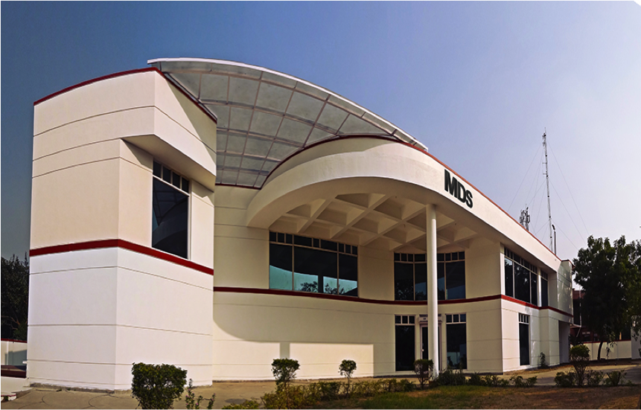
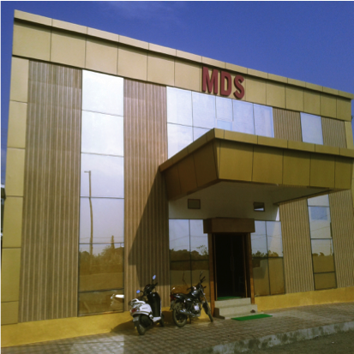
Our Offices
Development Centers in INDIA
Gurugram Development Center
Dehradun Development Center
You Description here
You Description here

Slide 4
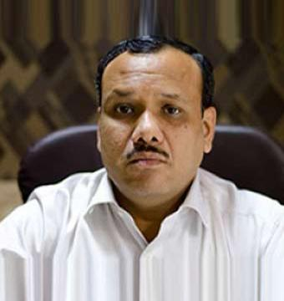
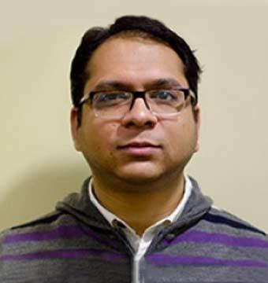
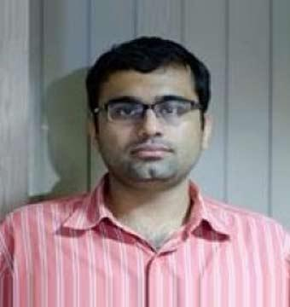
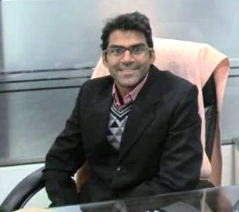

Meet Our Team
Senior Management Team
Sunil Goyal
Amit Gupta
Peeyush Tuli
Rajkumar Singh
CEO
CSO
CTO
CFO
Overseeing all operations and business activities to ensure they produce the desired results and are consistent with the overall strategy and mission
Developing high quality business strategies and plans ensuring their alignment with short-term and long-term objectives
Developing the company’s strategy for using technological resources. Ensuring technologies are used efficiently, profitably and securely
Analyzing data to support business decision-making. Managing financial reporting, budgeting and forecasting

Slide 5
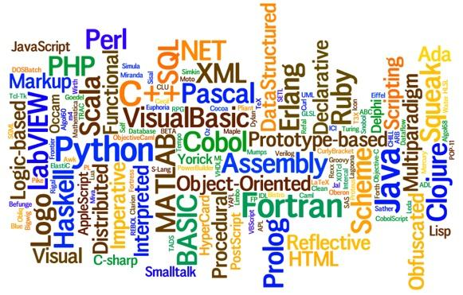
OUR EXPERTISE

Slide 6
Game Design and Development
Mobile, PC, Web and Console
Unity3D
2D/3D Game and Application Development .
Game Concept and Design
2D/3D Game Concept and Design
Cocos2D
Single Player and Multi Player Web and Mobile Game Development
AR / VR Development
Augmented Reality and Virtual Reality Games and Applications
Flash to HTML5 Porting
There are many variations of passages of loran Epsom.

Slide 7
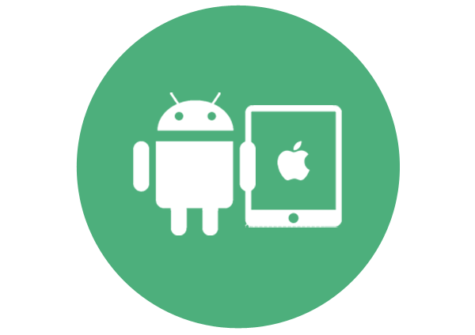
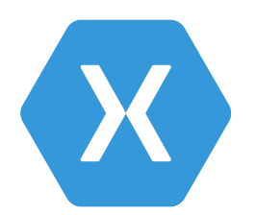


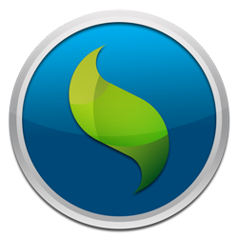
Mobile App Development
Native, Hybrid and Cross Mobile App Development Techniques
Cross Mobile Development
Hybrid
01
02
03
04
05
Native Development
Built specifically for a particular Mobile OS (Objective - C or Swift for iOS & Java for Android)
Xamarin
With Xamarin you can build native apps for multiple platforms on a shared C# codebase.
Ionic Framework
The top open source framework for building hybrid mobile apps. Ionic uses Cordova or PhoneGap to deploy natively, or runs in the browser as a Progressive Web App.
React Native
With React Native, you don't build a “HTML5 app”, or a “hybrid app”. You build a real mobile app that's indistinguishable from an app built using Objective-C or Java.
Sencha Touch
Sencha Touch is a UI JavaScript library, specifically built for the Mobile Web. It can be used to develop user interfaces for mobile web applications

Slide 8
MDS is a prefferd software company for these Services
Android App Development Company in India
iPhone App Development Company In India
Java Development Company in India
ASP.NET Development Company India
PHP Development Company in India
Adobe Plug-in Development
Game Development
Software Testing Services
Sales-force Development
CMS Development

Slide 9









Web Backend Technologies
Enterprise and Open Source
Ruby on Rails
Custom Web Applications
iOS and Android
Responsive UI and web services
PHP
CMS Development
Web Application Development Portal Development Solutions
Microsoft .NET
MVC Development
Desktop/Web app Development
Office Plug-in Development
Python
Web Development
Django Development
Google App Engine Cloud Platform
NodeJS
Node.JS API Development
Interactive App Development
Plug-ins Development
J2EE
Mobile App Development
Custom Java Development Java web API development
GO Lang
Web development
Golang Unit testing
Golang Mobile Development
Delphi
Delphi Web development services
Delhi Enterprise App Development
Scala
Scala Consulting
Scala Web App Development
Scala App Re-Engineering

Slide 10



Software QA Services
Automation QA
Have extensive expertise in Automation tools like Selenium, Appium, SAHI
Manual Functional QA
Offers varied services like test consulting, test governance, ,test maturity assessment etc.
Security Testing
Vast experience in penetration testing of web app, website, mobile, software, network etc.

Slide 11





Frontend Technologies
Web frontend development
AngularJS
Dynamic web apps
Single page applications
Sencha + ExtJS
Designing & Building Web Apps
Developing mobile apps
ReactJS
Web & Mobile application development Native app development
Plugin development
Adobe Flex
Template Design
Adobe AIR Development
Streaming Audio / Video Player
PUG+NodeJS
Node.JS API Development
Web App & Website Development
Node.js for UX/UI Design
EmberJS
Web App Development
Custom Widgets
Migration Services

Slide 12






Other Software Development Services
Salesforce Development
Adobe Plugin Development
Adobe InDesign , Premiere pro, Photoshop, Illustrator, After effects
MS Dynamics Development
AEM Development
MS Office Plug-in Development
Word, PowerPoint, Excel and Outlook.
SharePoint Development
ecommerce Development
Magento, Shopify, PrestoShop, Woocommerce
Word Press / Drupal / Joomla Development
App Development for Wearable's & Smart Devices
Tizen, Android Wear, Apple TV, iOS
UX Design Services
Mobile and Web UX Design Service

Slide 13
Global Customer Footprint
We serve customer globally
30%
35%
10%
5%
5%
15%

Slide 14
Thank You

